Slide 1
W4111 – Introduction to Databases Section 002, Fall 2023 Lecture 8: Finishing ER, Relational, SQL Starting Module II and NoSQL
© Donald F. Ferguson, 2023

Slide 2

Contents
2 | COMS W4111_002_2023_3: Lecture 8: ER, Relational, SQL Final; Module II; NoSQL © Donald F. Ferguson, 2023

Slide 3
Codd’s Rules Discussion
3 | COMS W4111_002_2023_1: Lecture 8: ER, Relational, SQL Final; Module II; NoSQL © Donald F. Ferguson, 2023

Slide 4
Codd’s 12 Rules
Rule 4: Active Online Catalog
The structure description of the entire database must be stored in an online catalog, known as data dictionary, which can be accessed by authorized users. Users can use the same query language to access the catalog which they use to access the database itself.
Rule 5: Comprehensive Data Sub-Language Rule
A database can only be accessed using a language having linear syntax that supports data definition, data manipulation, and transaction management operations. This language can be used directly or by means of some application. If the database allows access to data without any help of this language, then it is considered as a violation.
Rule 6: View Updating Rule
All the views of a database, which can theoretically be updated, must also be updatable by the system.
Rule 1: Information Rule
The data stored in a database, may it be user data or metadata, must be a value of some table cell. Everything in a database must be stored in a table format.
Rule 2: Guaranteed Access Rule
Every single data element (value) is guaranteed to be accessible logically with a combination of table-name, primary-key (row value), and attribute-name (column value). No other means, such as pointers, can be used to access data.
Rule 3: Systematic Treatment of NULL Values
The NULL values in a database must be given a systematic and uniform treatment. This is a very important rule because a NULL can be interpreted as one the following − data is missing, data is not known, or data is not applicable.
URL Like

Slide 5
Codd’s 12 Rules
Rule 10: Integrity Independence
A database must be independent of the application that uses it. All its integrity constraints can be independently modified without the need of any change in the application. This rule makes a database independent of the front-end application and its interface.
Rule 11: Distribution Independence
The end-user must not be able to see that the data is distributed over various locations. Users should always get the impression that the data is located at one site only. This rule has been regarded as the foundation of distributed database systems.
Rule 12: Non-Subversion Rule
If a system has an interface that provides access to low-level records, then the interface must not be able to subvert the system and bypass security and integrity constraints.
Rule 7: High-Level Insert, Update, and Delete Rule
A database must support high-level insertion, updation, and deletion. This must not be limited to a single row, that is, it must also support union, intersection and minus operations to yield sets of data records.
Rule 8: Physical Data Independence
The data stored in a database must be independent of the applications that access the database. Any change in the physical structure of a database must not have any impact on how the data is being accessed by external applications.
Rule 9: Logical Data Independence
The logical data in a database must be independent of its user’s view (application). Any change in logical data must not affect the applications using it. For example, if two tables are merged or one is split into two different tables, there should be no impact or change on the user application. This is one of the most difficult rule to apply.

Slide 6
ER Modeling Continued
6 | COMS W4111_002_2023_3: Lecture 8: ER, Relational, SQL Final; Module II; NoSQL © Donald F. Ferguson, 2023

Slide 7
Mapping Cardinality Constraints
Express the number of entities to which another entity can be associated via a relationship set.
Most useful in describing binary relationship sets.
For a binary relationship set the mapping cardinality must be one of the following types:
One to one
One to many
Many to one
Many to many

Slide 8
Aggregation
Consider the ternary relationship proj_guide, which we saw earlier
Suppose we want to record evaluations of a student by a guide on a project

Slide 9
Aggregation (Cont.)
Relationship sets eval_for and proj_guide represent overlapping information
Every eval_for relationship corresponds to a proj_guide relationship
However, some proj_guide relationships may not correspond to any eval_for relationships
So we can’t discard the proj_guide relationship
Eliminate this redundancy via aggregation
Treat relationship as an abstract entity
Allows relationships between relationships
Abstraction of relationship into new entity

Slide 10
Aggregation (Cont.)
Eliminate this redundancy via aggregation without introducing redundancy, the following diagram represents:
A student is guided by a particular instructor on a particular project
A student, instructor, project combination may have an associated evaluation
Notes:
10

Slide 11
Reduction to Relational Schemas
To represent aggregation, create a schema containing
Primary key of the aggregated relationship,
The primary key of the associated entity set
Any descriptive attributes
In our example:
The schema eval_for is:
eval_for (s_ID, project_id, i_ID, evaluation_id)
The schema proj_guide is redundant.

Slide 12
Specialization
Top-down design process; we designate sub-groupings within an entity set that are distinctive from other entities in the set.
These sub-groupings become lower-level entity sets that have attributes or participate in relationships that do not apply to the higher-level entity set.
Depicted by a triangle component labeled ISA (e.g., instructor “is a” person).
Attribute inheritance – a lower-level entity set inherits all the attributes and relationship participation of the higher-level entity set to which it is linked.

Slide 13
Functions, Procedures, Triggers
13 | COMS W4111_002_2023_1: Lecture 8: ER, Relational, SQL Final; Module II; NoSQL © Donald F. Ferguson, 2023

Slide 14

Summary
14 | COMS W4111_002_2023_1: Lecture 8: ER, Relational, SQL Final; Module II; NoSQL © Donald F. Ferguson, 2023

Slide 15
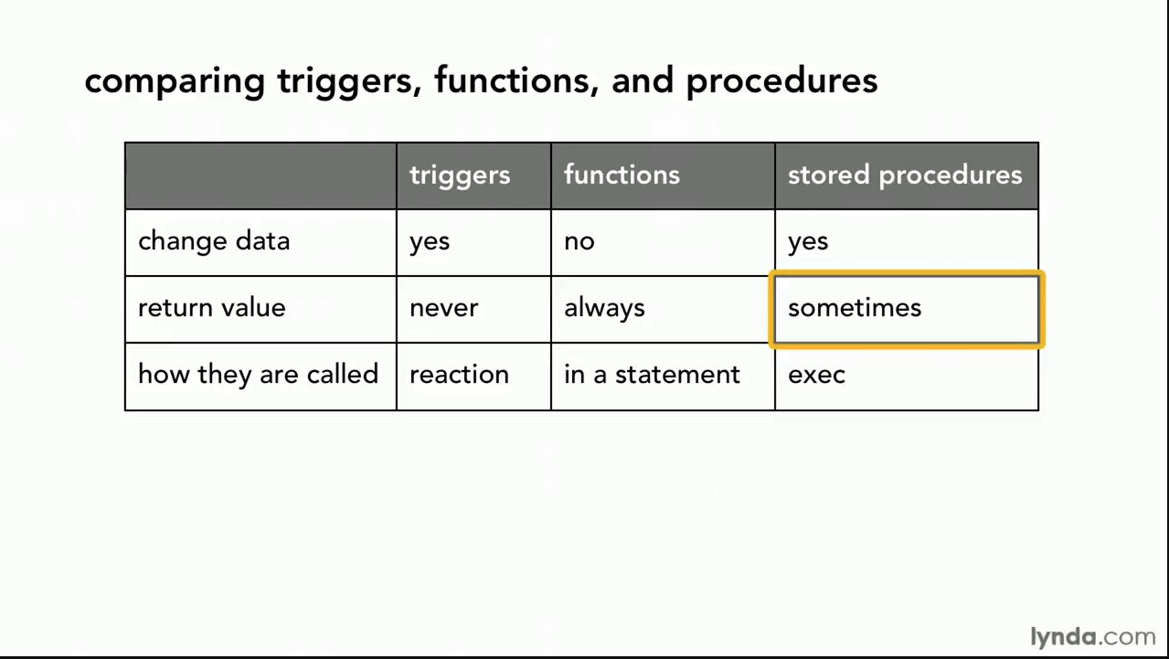
Comparison

Slide 16
Comparison – Some Details
A trigger has capabilities like a procedure, except ...
You do not call it. The DB engine calls it before or after an INSERT, UPDATE, DELETE.
The inputs are the list of incoming new, modified rows.
The outputs are the modified versions of the new or modified rows.

Slide 17
Triggers
17 | COMS W4111_002_2023_1: Lecture 8: ER, Relational, SQL Final; Module II; NoSQL © Donald F. Ferguson, 2023

Slide 18
Triggers
A trigger is a statement that is executed automatically by the system as a side effect of a modification to the database.
To design a trigger mechanism, we must:
Specify the conditions under which the trigger is to be executed.
Specify the actions to be taken when the trigger executes.
Triggers introduced to SQL standard in SQL:1999, but supported even earlier using non-standard syntax by most databases.
Syntax illustrated here may not work exactly on your database system; check the system manuals

Slide 19
Triggering Events and Actions in SQL
Triggering event can be insert, delete or update
Triggers on update can be restricted to specific attributes
For example, after update of takes on grade
Values of attributes before and after an update can be referenced
referencing old row as : for deletes and updates
referencing new row as : for inserts and updates
Triggers can be activated before an event, which can serve as extra constraints. For example, convert blank grades to null.
create trigger setnull_trigger before update of takes referencing new row as nrow for each row when (nrow.grade = ' ') begin atomic set nrow.grade = null; end;

Slide 20
Trigger to Maintain credits_earned value
create trigger credits_earned after update of takes on (grade) referencing new row as nrow referencing old row as orow for each row when nrow.grade <> 'F' and nrow.grade is not null and (orow.grade = 'F' or orow.grade is null) begin atomic update student set tot_cred= tot_cred + (select credits from course where course.course_id= nrow.course_id) where student.id = nrow.id; end;

Slide 21
Statement Level Triggers
Instead of executing a separate action for each affected row, a single action can be executed for all rows affected by a transaction
Use for each statement instead of for each row
Use referencing old table or referencing new table to refer to temporary tables (called transition tables) containing the affected rows
Can be more efficient when dealing with SQL statements that update a large number of rows

Slide 22
When Not To Use Triggers
Triggers were used earlier for tasks such as
Maintaining summary data (e.g., total salary of each department)
Replicating databases by recording changes to special relations (called change or delta relations) and having a separate process that applies the changes over to a replica
There are better ways of doing these now:
Databases today provide built in materialized view facilities to maintain summary data
Databases provide built-in support for replication
Encapsulation facilities can be used instead of triggers in many cases
Define methods to update fields
Carry out actions as part of the update methods instead of through a trigger

Slide 23
When Not To Use Triggers (Cont.)
Risk of unintended execution of triggers, for example, when
Loading data from a backup copy
Replicating updates at a remote site
Trigger execution can be disabled before such actions.
Other risks with triggers:
Error leading to failure of critical transactions that set off the trigger
Cascading execution

Slide 24
Security
24 | COMS W4111_002_2023_1: Lecture 8: ER, Relational, SQL Final; Module II; NoSQL © Donald F. Ferguson, 2023

Slide 25
Security Concepts (Terms from Wikipedia)
Definitions:
“A (digital) identity is information on an entity used by computer systems to represent an external agent. That agent may be a person, organization, application, or device.”
“Authentication is the act of proving an assertion, such as the identity of a computer system user. In contrast with identification, the act of indicating a person or thing's identity, authentication is the process of verifying that identity.”
“Authorization is the function of specifying access rights/privileges to resources, ... More formally, "to authorize" is to define an access policy. ... During operation, the system uses the access control rules to decide whether access requests from (authenticated) consumers shall be approved (granted) or disapproved.
“Within an organization, roles are created for various job functions. The permissions to perform certain operations are assigned to specific roles. Members or staff (or other system users) are assigned particular roles, and through those role assignments acquire the permissions needed to perform particular system functions.”
“In computing, privilege is defined as the delegation of authority to perform security-relevant functions on a computer system. A privilege allows a user to perform an action with security consequences. Examples of various privileges include the ability to create a new user, install software, or change kernel functions.”
SQL and relational database management systems implementing security by:
Creating identities and authentication policies.
Creating roles and assigning identities to roles.
Granting and revoking privileges to/from roles and identities.

Slide 26
Authorization
We may assign a user several forms of authorizations on parts of the database.
Read - allows reading, but not modification of data.
Insert - allows insertion of new data, but not modification of existing data.
Update - allows modification, but not deletion of data.
Delete - allows deletion of data.
Each of these types of authorizations is called a privilege. We may authorize the user all, none, or a combination of these types of privileges on specified parts of a database, such as a relation or a view.
(identity of the data, operation/verb, identity of person)
(database.table, {insert, delete, update, select}, root@localhost)

Slide 27
Authorization (Cont.)
Forms of authorization to modify the database schema
Index - allows creation and deletion of indices.
Resources - allows creation of new relations.
Alteration - allows addition or deletion of attributes in a relation.
Drop - allows deletion of relations.

Slide 28
Authorization Specification in SQL
The grant statement is used to confer authorization
grant <privilege list> on <relation or view > to <user list>
<user list> is:
a user-id
public, which allows all valid users the privilege granted
A role (more on this later)
Example:
grant select on department to Amit, Satoshi
Granting a privilege on a view does not imply granting any privileges on the underlying relations.
The grantor of the privilege must already hold the privilege on the specified item (or be the database administrator).

Slide 29
Privileges in SQL
select: allows read access to relation, or the ability to query using the view
Example: grant users U₁, U₂, and U₃ select authorization on the instructor relation:
grant select on instructor to U₁, U₂, U₃
insert: the ability to insert tuples
update: the ability to update using the SQL update statement
delete: the ability to delete tuples.
all privileges: used as a short form for all the allowable privileges

Slide 30
Revoking Authorization in SQL
The revoke statement is used to revoke authorization.
revoke <privilege list> on <relation or view> from <user list>
Example:
revoke select on student from U₁, U₂, U₃
<privilege-list> may be all to revoke all privileges the revokee may hold.
If <revokee-list> includes public, all users lose the privilege except those granted it explicitly.
If the same privilege was granted twice to the same user by different grantees, the user may retain the privilege after the revocation.
All privileges that depend on the privilege being revoked are also revoked.

Slide 31
Roles
A role is a way to distinguish among various users as far as what these users can access/update in the database.
To create a role we use:
create a role <name>
Example:
create role instructor
Once a role is created we can assign “users” to the role using:
grant <role> to <users>

Slide 32
Roles Example
create role instructor;
grant instructor to Amit;
Privileges can be granted to roles:
grant select on takes to instructor;
Roles can be granted to users, as well as to other roles
create role teaching_assistant
grant teaching_assistant to instructor;
Instructor inherits all privileges of teaching_assistant
Chain of roles
create role dean;
grant instructor to dean;
grant dean to Satoshi;

Slide 33
Authorization on Views
create view geo_instructor as (select * from instructor where dept_name = 'Geology');
grant select on geo_instructor to geo_staff
Suppose that a geo_staff member issues
select * from geo_instructor;
What if
geo_staff does not have permissions on instructor?
Creator of view did not have some permissions on instructor?

Slide 34
Other Authorization Features
references privilege to create foreign key
grant reference (dept_name) on department to Mariano;
Why is this required?
transfer of privileges
grant select on department to Amit with grant option;
revoke select on department from Amit, Satoshi cascade;
revoke select on department from Amit, Satoshi restrict;
And more!
Note:
Like in many other cases, SQL DBMS have product specific variations.
Switch to notebook.

Slide 35
Some Advanced SQL
35 | COMS W4111_002_2023_1: Lecture 8: ER, Relational, SQL Final; Module II; NoSQL © Donald F. Ferguson, 2023

Slide 36
Recursive Queries
I do not recommend this.
36 | COMS W4111_002_2023_1: Lecture 8: ER, Relational, SQL Final; Module II; NoSQL © Donald F. Ferguson, 2023

Slide 37
Module II Kickoff
37 | COMS W4111_002_2023_1: Lecture 8: ER, Relational, SQL Final; Module II; NoSQL © Donald F. Ferguson, 2023

Slide 38
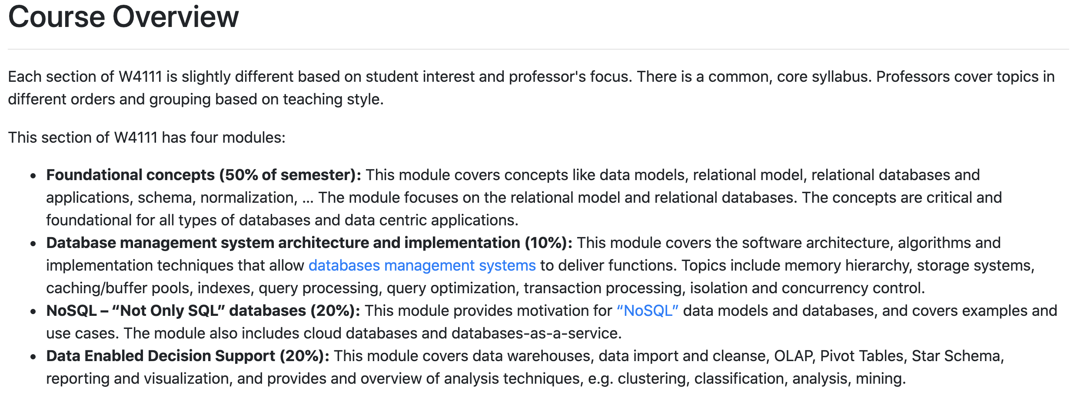
Course Modules – Reminder

Slide 39
Module II – DBMS Architecture and Implementation
Overview and Reminder
39 | COMS W4111_002_2023_1: Lecture 8: ER, Relational, SQL Final; Module II; NoSQL © Donald F. Ferguson, 2023

Slide 40
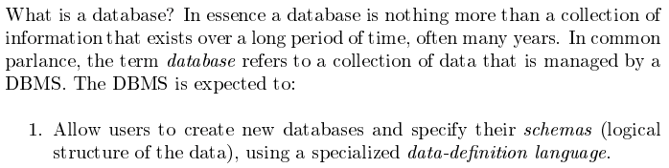
Module II – DBMS Architecture and Implementation
Covered for the relational model.
Database Systems: The Complete Book (2nd Edition) by Hector Garcia-Molina (Author), Jeffrey D. Ullman (Author), Jennifer Widom (Author)

Slide 41
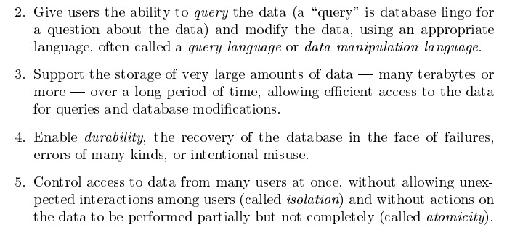
Module II – DBMS Architecture and Implementation
Database Systems: The Complete Book (2nd Edition) by Hector Garcia-Molina (Author), Jeffrey D. Ullman (Author), Jennifer Widom (Author)

Slide 42
Purpose of Database Systems
In the early days, database applications were built directly on top of file systems, which leads to:
Data redundancy and inconsistency: data is stored in multiple file formats resulting in duplication of information in different files
Difficulty in accessing data
Need to write a new program to carry out each new task
Data isolation
Multiple files and formats
Integrity problems
Integrity constraints (e.g., account balance > 0) become “buried” in program code rather than being stated explicitly
Hard to add new constraints or change existing ones
Notes:
42

Slide 43
Purpose of Database Systems (Cont.)
Atomicity of updates
Failures may leave database in an inconsistent state with partial updates carried out
Example: Transfer of funds from one account to another should either complete or not happen at all
Concurrent access by multiple users
Concurrent access needed for performance
Uncontrolled concurrent accesses can lead to inconsistencies
Ex: Two people reading a balance (say 100) and updating it by withdrawing money (say 50 each) at the same time
Security problems
Hard to provide user access to some, but not all, data
Database systems offer solutions to all the above problems. In module I, we explored how users interact with the (some) of the functions through DDL and DML. In module II, we will explore how DBMS implement the capabilities “under the covers.”
In
Notes:
43

Slide 44
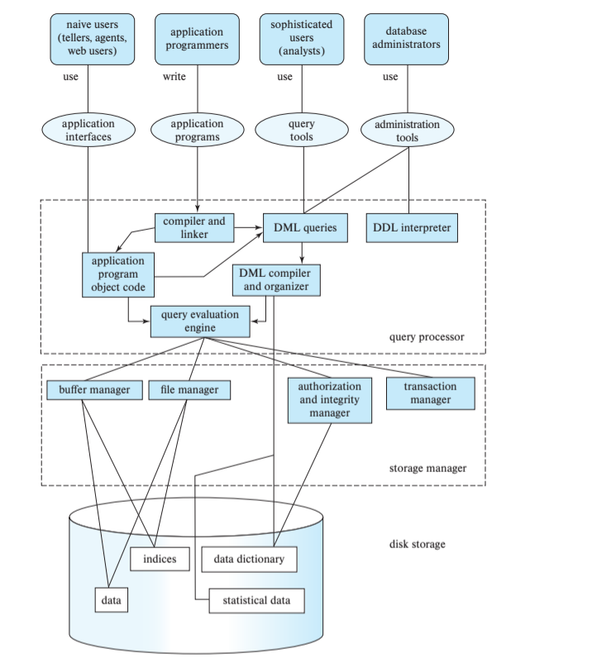
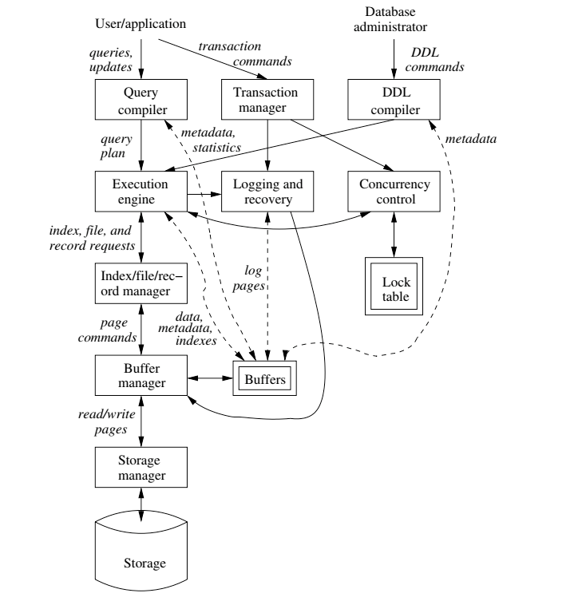
DBMS Arch.

Slide 45

Data Management
Today
Load/save things quickly.
Database Systems: The Complete Book (2nd Edition) by Hector Garcia-Molina (Author), Jeffrey D. Ullman (Author), Jennifer Widom (Author)

Slide 46
Disks Input/Output (IO)
46 | COMS W4111_002_2023_1: Lecture 8: ER, Relational, SQL Final; Module II; NoSQL © Donald F. Ferguson, 2023

Slide 47
Disks as Far as the Eye can See

Slide 48
Classification of Physical Storage Media
Can differentiate storage into:
volatile storage: loses contents when power is switched off
non-volatile storage:
Contents persist even when power is switched off.
Includes secondary and tertiary storage, as well as batter-backed up main-memory.
Factors affecting choice of storage media include
Speed with which data can be accessed
Cost per unit of data
Reliability
From: Database System Concepts, 7th Ed.

Slide 49
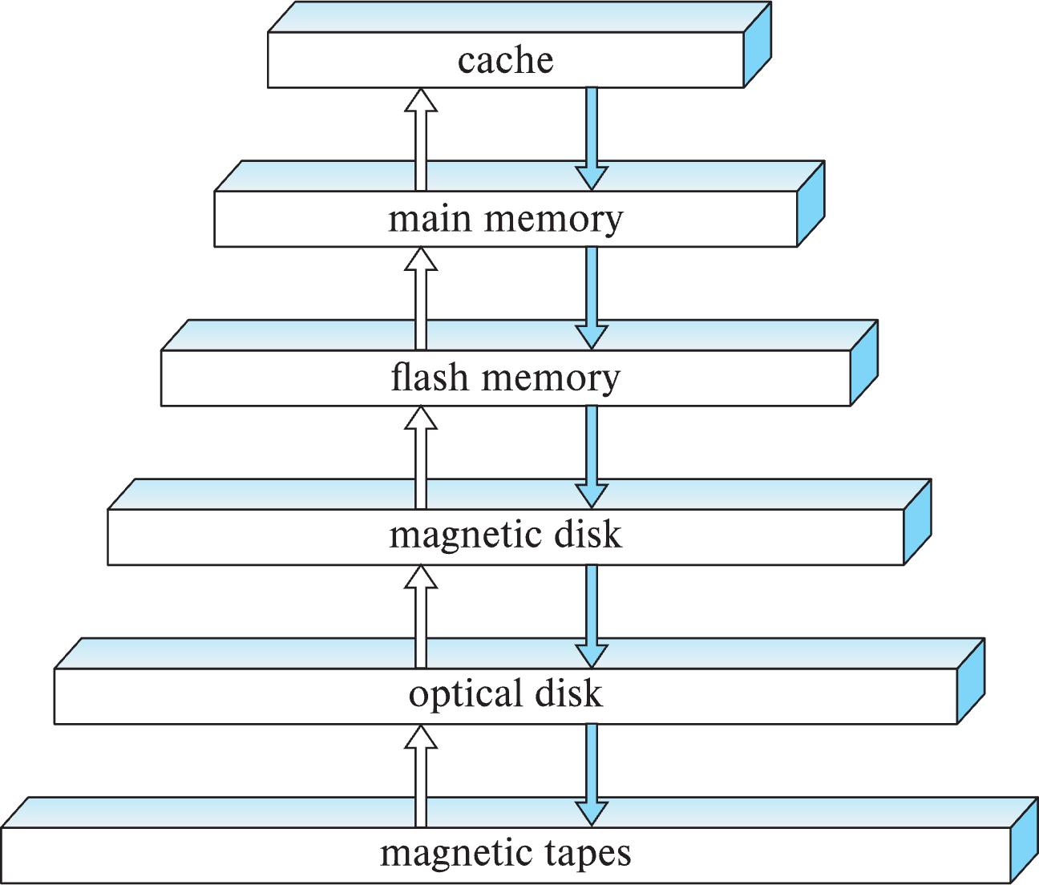
Storage Hierarchy
CPU
CPU
C
DC
NC
From: Database System Concepts, 7th Ed.

Slide 50
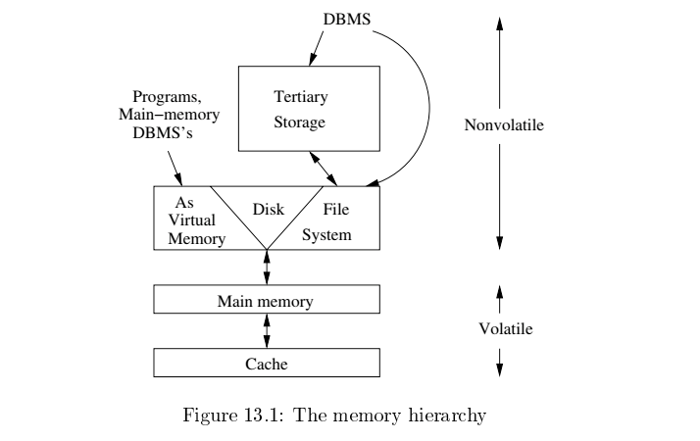
Memory Hierarchy
Slower
Cheaper
Unlimited
Faster
More expensive
Limited
From: Database System Concepts, 7th Ed.

Slide 51
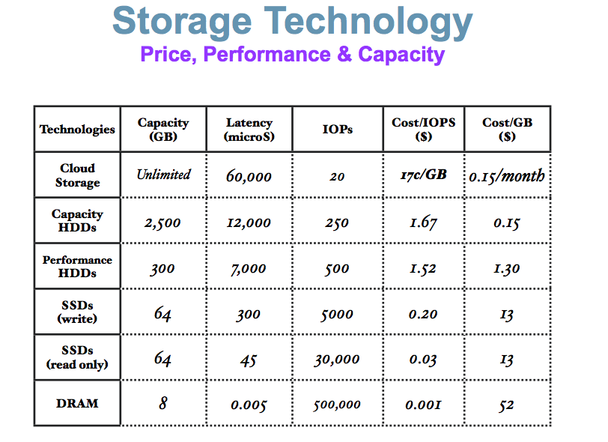
Memory Hierarchy (Very Old Numbers – Still Directionally Valid)
These numbers are ancient.
Looking for more modern numbers.
But, does give an idea of
Price
Performance
The general observation is that
Performance goes up 10X/level.
Price goes up 10x per level.
Note: One major change is improved price performance of SDD relative to HDD for large data.

Slide 52
Storage Hierarchy (Cont.)
primary storage: Fastest media but volatile (cache, main memory).
secondary storage: next level in hierarchy, non-volatile, moderately fast access time
Also called on-line storage
E.g., flash memory, magnetic disks
tertiary storage: lowest level in hierarchy, non-volatile, slow access time
also called off-line storage and used for archival storage
e.g., magnetic tape, optical storage
Magnetic tape
Sequential access, 1 to 12 TB capacity
A few drives with many tapes
Juke boxes with petabytes (1000’s of TB) of storage
From: Database System Concepts, 7th Ed.

Slide 53
Hard Disk Drive

Slide 54
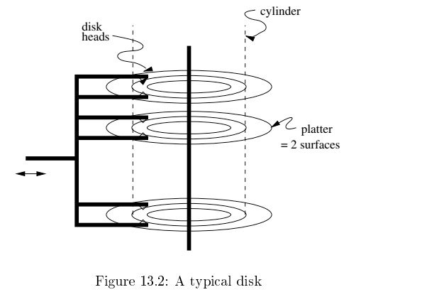
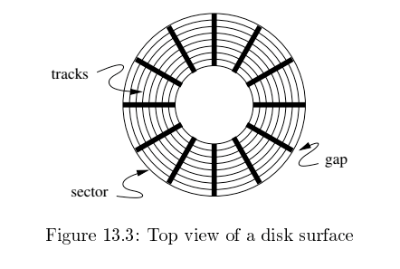
Disk Configuration
Components of disk I/O delay
Seek: Move head to cylinder/track.
Rotation: Wait for sector to get under head.
Transfer: Move data from disk to memory.
Database Systems: The Complete Book (2nd Edition) by Hector Garcia-Molina (Author), Jeffrey D. Ullman (Author), Jennifer Widom (Author)

Slide 55
Hard Disk versus Solid State Disk
Hard
Disk
Drive
Solid
State
Drive

Slide 56
Flash Storage
NOR flash vs NAND flash
NAND flash
used widely for storage, cheaper than NOR flash
requires page-at-a-time read (page: 512 bytes to 4 KB)
20 to 100 microseconds for a page read
Not much difference between sequential and random read
Page can only be written once
Must be erased to allow rewrite
Solid state disks
Use standard block-oriented disk interfaces, but store data on multiple flash storage devices internally
Transfer rate of up to 500 MB/sec using SATA, and up to 3 GB/sec using NVMe PCIe
From: Database System Concepts, 7th Ed.
Despite the radically different implementation, it has a disk oriented API.

Slide 57
Logical Block Addressing
Concept:
The unit of transfer from a “disk” to the computers memory is a “block. Blocks are usually relatively large, e.g. 16 KB, 32 KB, ... ...
A program that reads or write a single byte, requires the database engine (or file system) to read/write the entire block.
The address of a block in the entire space of blocks is:
(Device ID, Block ID)
Block ID is simple 0, 1, 2, ... ...
The disk controller and disk implementation translate the logical block address into the physical address of blocks.
The physical address changes over time for various reasons, e.g. performance optimization, internal HW failure, etc.

Slide 58
Logical/Physical Block Addressing
The mapping from LBA to physical block address can change over time.
Internal HW failure.
SSD writes in a funny way.
You have to erase before writing.
So, the SSD (for performance)
Writes to an empty block.
Erase the original block.
Performance optimization on HDD
Based on block access patterns.
Place blocks on cylinder/sector/head in a way to minimize:
Seek
Rotate
Processor
Mech Controller
Buffer

Slide 59
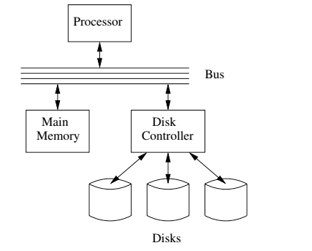
I/O Architecture
Large scale environments
The bus-controller connection is over some kind of network.
The disk controller is at the disks, and basically a “computer” with SW.
Network is either
Standard communication network, or
Highly optimized I/O network.
How we normally think of disks and I/O.

Slide 60
Magnetic Disks
Read-write head
Surface of platter divided into circular tracks
Over 50K-100K tracks per platter on typical hard disks
Each track is divided into sectors.
A sector is the smallest unit of data that can be read or written.
Sector size typically 512 bytes
Typical sectors per track: 500 to 1000 (on inner tracks) to 1000 to 2000 (on outer tracks)
To read/write a sector
disk arm swings to position head on right track
platter spins continually; data is read/written as sector passes under head
Head-disk assemblies
multiple disk platters on a single spindle (1 to 5 usually)
one head per platter, mounted on a common arm.
Cylinder i consists of i^{th} track of all the platters
From: Database System Concepts, 7th Ed.
Notes:
Mention: checksums, bad sector remapping

Slide 61
Magnetic Disks (Cont.)
Disk controller – interfaces between the computer system and the disk drive hardware.
accepts high-level commands to read or write a sector
initiates actions such as moving the disk arm to the right track and actually reading or writing the data
Computes and attaches checksums to each sector to verify that data is read back correctly
If data is corrupted, with very high probability stored checksum won’t match recomputed checksum
Ensures successful writing by reading back sector after writing it
Performs remapping of bad sectors
From: Database System Concepts, 7th Ed.

Slide 62
Performance Measures of Disks
Access time – the time it takes from when a read or write request is issued to when data transfer begins. Consists of:
Seek time – time it takes to reposition the arm over the correct track.
Average seek time is 1/2 the worst case seek time.
Would be 1/3 if all tracks had the same number of sectors, and we ignore the time to start and stop arm movement
4 to 10 milliseconds on typical disks
Rotational latency – time it takes for the sector to be accessed to appear under the head.
4 to 11 milliseconds on typical disks (5400 to 15000 r.p.m.)
Average latency is 1/2 of the above latency.
Overall latency is 5 to 20 msec depending on disk model
Data-transfer rate – the rate at which data can be retrieved from or stored to the disk.
25 to 200 MB per second max rate, lower for inner tracks
From: Database System Concepts, 7th Ed.

Slide 63
Performance Measures (Cont.)
Disk block is a logical unit for storage allocation and retrieval
4 to 16 kilobytes typically
Smaller blocks: more transfers from disk
Larger blocks: more space wasted due to partially filled blocks
Sequential access pattern
Successive requests are for successive disk blocks
Disk seek required only for first block
Random access pattern
Successive requests are for blocks that can be anywhere on disk
Each access requires a seek
Transfer rates are low since a lot of time is wasted in seeks
I/O operations per second (IOPS)
Number of random block reads that a disk can support per second
50 to 200 IOPS on current generation magnetic disks
From: Database System Concepts, 7th Ed.

Slide 64
Performance Measures (Cont.)
Mean time to failure (MTTF) – the average time the disk is expected to run continuously without any failure.
Typically 3 to 5 years
Probability of failure of new disks is quite low, corresponding to a “theoretical MTTF” of 500,000 to 1,200,000 hours for a new disk
E.g., an MTTF of 1,200,000 hours for a new disk means that given 1000 relatively new disks, on an average one will fail every 1200 hours
MTTF decreases as disk ages
From: Database System Concepts, 7th Ed.

Slide 65
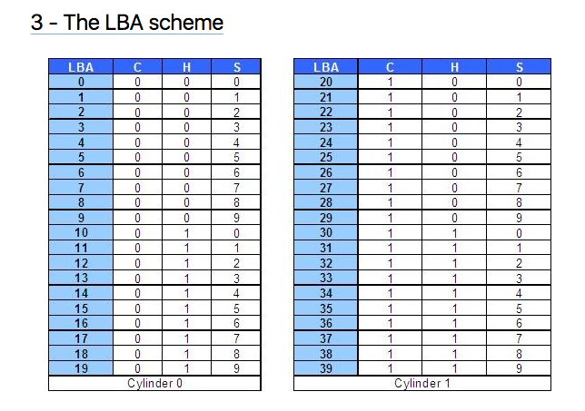
Logical Block Addressing (https://gerardnico.com/wiki/data_storage/lba)
CHS addresses can be converted to LBA addresses using the following formula:
LBA = (( C x HPC ) + H ) x SPT + S – 1
where,
C, H and S are the cylinder number, the head number, and the sector number
LBA is the logical block address
HPC is the number of heads per cylinder
SPT is the number of sectors per track
Devices have configuration and metadata APIs that allow storage manager to
Map between LBA and CHS
To optimize block placement
Based on access patterns, statistics, data schema, etc.

Slide 66
I/O Architecture
Redundant Array of Independent Disks (RAID)

Slide 67
RAID (https://en.wikipedia.org/wiki/RAID)
“RAID (redundant array of independent disks) is a data storage virtualization technology that combines multiple physical disk drive components into a single logical unit for the purposes of data redundancy, performance improvement, or both. (…)
RAID 0 consists of striping, without mirroring or parity. (…)
RAID 1 consists of data mirroring, without parity or striping. (…)
RAID 2 consists of bit-level striping with dedicated Hamming-code parity. (…)
RAID 3 consists of byte-level striping with dedicated parity. (…)
RAID 4 consists of block-level striping with dedicated parity. (…)
RAID 5 consists of block-level striping with distributed parity. (…)
RAID 6 consists of block-level striping with double distributed parity. (…)
Nested RAID
RAID 0+1: creates two stripes and mirrors them. (…)
RAID 1+0: creates a striped set from a series of mirrored drives. (…)
JBOD RAID N+N: With JBOD (just a bunch of disks), (…)”

Slide 68
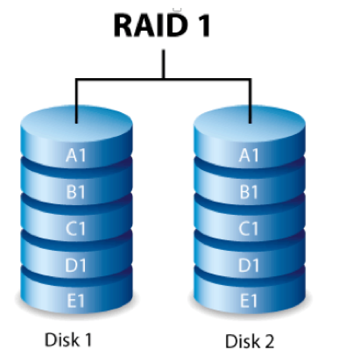
RAID-0 and RAID-1
Two physical disks make one single, logical fast disk
Two physical disks make one single, logical reliable disk
Single “Fast” Disk
Single “Reliable” Disk

Slide 69
Mixed RAID Modes
Stripe
And
Mirror

Slide 70
RAID-5
One Big Logical Disk
Improved performance through parallelism
Rotation/seek
Transfer
Availability uses parity blocks
Suppose I have 4 different data blocks on the logical drive A: A1, A2, A3, A4.
Parity function: Ap = P(A1,A2,A3,A4)
Recovery function: A2=R(Ap,A1,A3,A4)
During normal operations:
Read processing simply retrieves block.
Write processing of A2 updates A2 and Ap
If an individual disk fails, the RAID
Read
Continues to function for reads on non-missing blocks.
Implements read on missing block by recalculating value.
Write
Updates block and parity block for non-missing blocks.
Computes missing block, and calculates parity based on old and new value.
Over time
“Hot Swap” the failed disk.
Rebuild the missing data from values and parity.
Is actually 5 smaller “logical” disks.
A
B
C
D
E
Logical disk data spread over 5 physical disks.

Slide 71
Very Simple Parity Example
Even-Odd Parity
b[i] is an array of bits (0 or 1)
P(b[i]) =
0 is an even number of bits = 1. {P([0,1,1,0,1,1])= 0
1 if an odd number of bits = 1. {P(0,0,1,0,1,1]= 1
Given an array with one missing bit and the parity bit, I can re-compute the missing bit.
Case 1: [0,?,1,0,1,1] has P=0. There must be an EVEN number of ones and ?=1.
Case 2: [0,?,1,0,1,1] has P=1. There must be an ODD number of ones and ?=0.
Block Parity applies this to a set of blocks bitwise
A1=[0,1,0,0,1,1]
A2=[1,1,1,0,0,0]
A3=[0,0,0,1,0,1]
Pa=[1,0,1,1,1,0]
➔
If I am missing a block and have the parity block, I can re-compute the missing block bitwise from remaining blocks and parity block.

Slide 72
NoSQL
72 | COMS W4111_002_2023_1: Lecture 8: ER, Relational, SQL Final; Module II; NoSQL © Donald F. Ferguson, 2023

Slide 73
Concepts
73 | COMS W4111_002_2023_1: Lecture 8: ER, Relational, SQL Final; Module II; NoSQL © Donald F. Ferguson, 2023

Slide 74
Overview (I) (https://en.wikipedia.org/wiki/NoSQL)
A NoSQL (originally referring to "non SQL" or "non relational")^{[1]} database provides a mechanism for storage and retrieval of data that is modeled in means other than the tabular relations used in relational databases. Such databases have existed since the late 1960s, but did not obtain the "NoSQL" moniker until a surge of popularity in the early twenty-first century,^{[2]} triggered by the needs of Web 2.0 companies such as Facebook, Google, and Amazon.com.^{[3][4][5]} NoSQL databases are increasingly used in big data and real-time web applications.^{[6]} NoSQL systems are also sometimes called "Not only SQL" to emphasize that they may support SQL-like query languages.^{[7][8]}
Motivations for this approach include: simplicity of design, simpler "horizontal" scaling to clusters of machines (which is a problem for relational databases),^{[2]} and finer control over availability. The data structures used by NoSQL databases (e.g. key-value, wide column, graph, or document) are different from those used by default in relational databases, making some operations faster in NoSQL. The particular suitability of a given NoSQL database depends on the problem it must solve. Sometimes the data structures used by NoSQL databases are also viewed as "more flexible" than relational database tables.^{[9]}

Slide 75
Overview (I) (https://en.wikipedia.org/wiki/NoSQL)
Many NoSQL stores compromise consistency (in the sense of the CAP theorem) in favor of availability, partition tolerance, and speed. Barriers to the greater adoption of NoSQL stores include the use of low-level query languages (instead of SQL, for instance the lack of ability to perform ad-hoc joins across tables), lack of standardized interfaces, and huge previous investments in existing relational databases.^{[10]} Most NoSQL stores lack true ACID transactions, … …
Instead, most NoSQL databases offer a concept of "eventual consistency" in which database changes are propagated to all nodes "eventually" (typically within milliseconds) so queries for data might not return updated data immediately or might result in reading data that is not accurate, a problem known as stale reads.^{[11]} Additionally, some NoSQL systems may exhibit lost writes and other forms of data loss.^{[12]} Fortunately, some NoSQL systems provide concepts such as write-ahead logging to avoid data loss.^{[13]} For distributed transaction processing across multiple databases, data consistency is an even bigger challenge that is difficult for both NoSQL and relational databases. Even current relational databases "do not allow referential integrity constraints to span databases."^{[14]}

Slide 76
Simplistic Classification (https://medium.com/swlh/4-types-of-nosql-databases-d88ad21f7d3b)
Relational is the foundational model.
We will see OLAP in a future lecture.
Subject of this lecture and part of HW4
We covered graphs and examples.

Slide 77
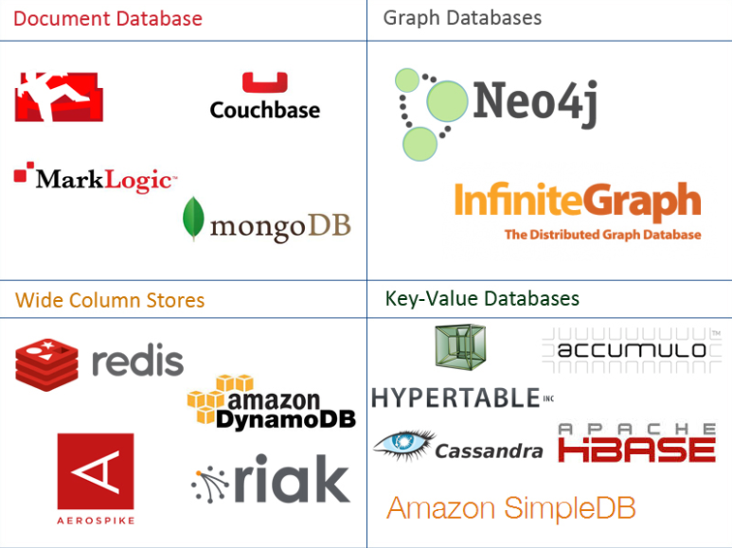
One Taxonomy

Slide 78
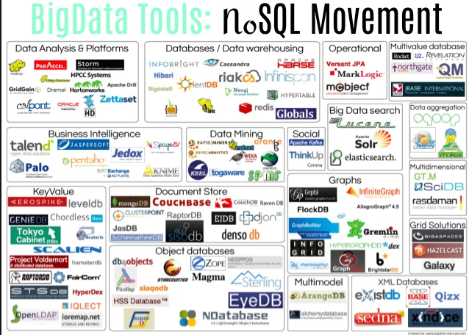
Another Taxonomy

Slide 79
Use Cases
Motivations
Massive write performance.
Fast key value look ups.
Flexible schema and data types.
No single point of failure.
Fast prototyping and development.
Out of the box scalability.
Easy maintenance.
What is wrong with SQL/Relational?
Nothing. One size fits all? Not really.
Impedance mismatch. – Object Relational Mapping doesn’t work quite well.
Rigid schema design.
Harder to scale.
Replication.
Joins across multiple nodes? Hard.
How does RDMS handle data growth? Hard.
Need for a DBA.
Many programmers are already familiar with it.
Transactions and ACID make development easy.
Lots of tools to use.

Slide 80
Documents
80 | COMS W4111_002_2023_1: Lecture 8: ER, Relational, SQL Final; Module II; NoSQL © Donald F. Ferguson, 2023

Slide 81
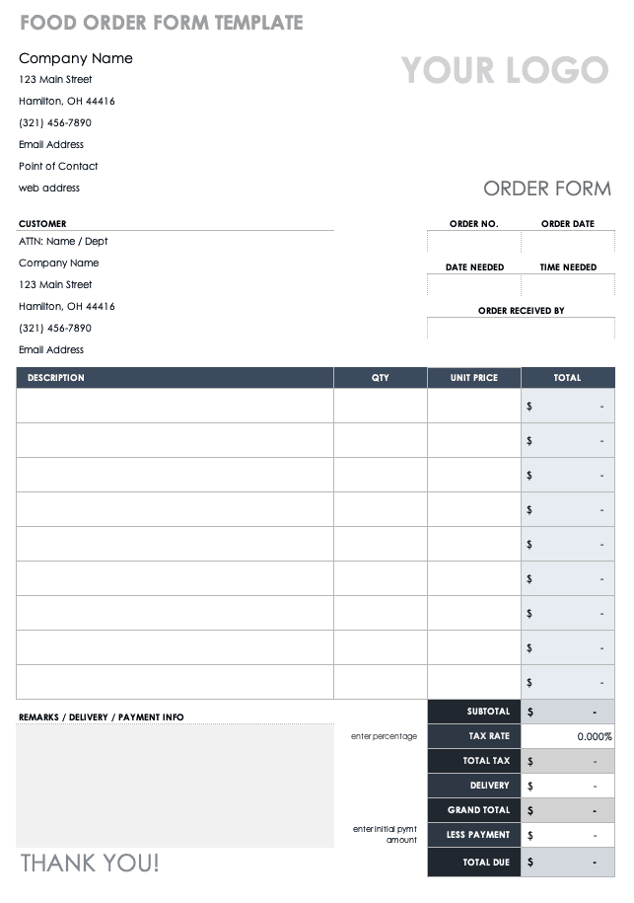
Example Document – An Order
There are 5 entity types on the form:
A “copy of” customer information.
Links (via productCode) to products
Order
OrderDetails
Comments
But OrderDetails and Comments are somehow different from the others.
These are arrays of objects
That are sort of “inside” the order.
These are weak entities, but relational does not always handle these well.

Slide 82
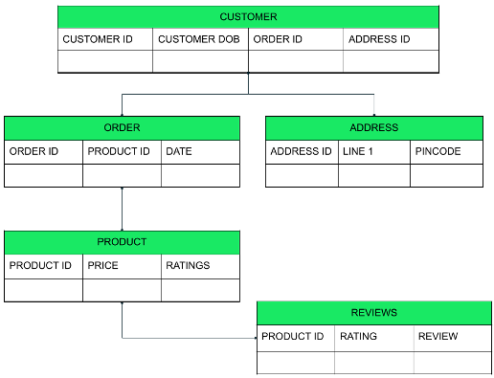
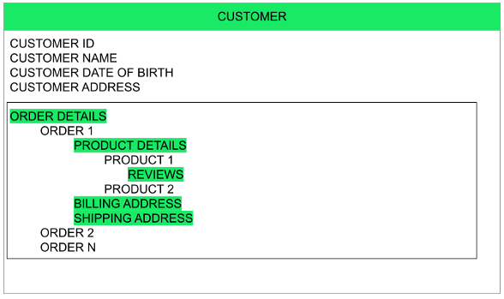
Relational vs Document
Relational
Relational
The key difference?
Relational DB attributes are atomic.
Document DB attributes may be multi-valued and complex.

Slide 83
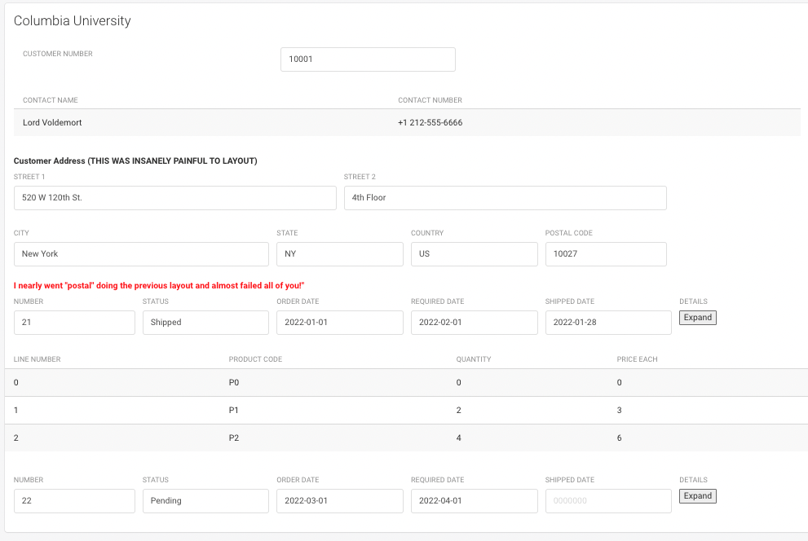
UI Interface and Logical Data Model
{
customerName: “Columbia University”,
contact: {
name: “Lord Voldemort”,
phone: “+1 212-555-6666”
},
address: {
line1: “520 W 120th St.”
line2: “Floor 4”,
… …
}
orders: [
{
number: …,
… …
details: [
… …
]
}
]
}

Slide 84
Switch to Notebook

Slide 85
MongoDB
85 | COMS W4111_002_2023_1: Lecture 8: ER, Relational, SQL Final; Module II; NoSQL © Donald F. Ferguson, 2023

Slide 86
MongoDB Concepts
RDBMS | MongoDB | MongoDB
Database | Database | Database
Table | Collection | Collection
Tuple/Row | Document | Document
column | Field | Field
Table Join | Embedded Documents | Embedded Documents
Primary Key | Primary Key (Default key _id provided by MongoDB itself) | Primary Key (Default key _id provided by MongoDB itself)
Database Server, Client, Tools, Packages
mysqld/Oracle |  | mongod
mysql/sqlplus |  | mongo
DataGrip |  | Compass
pymysql |  | pymongo

Slide 87
Core Operations
Basic Operations:
Create database
Create collection
Create-Retrieve-Update-Delete (CRUD):
Create: insert()
Retrieve:
find()
find_one()
Update: update()
Delete: remove()
More Advanced Concepts:
Limit
Sort
Aggregation Pipelines
Merge
Union
Lookup
Match
Merge
Sample
... ...
We will just cover the basics for now and may cover more things in HW or other lectures.

Slide 88
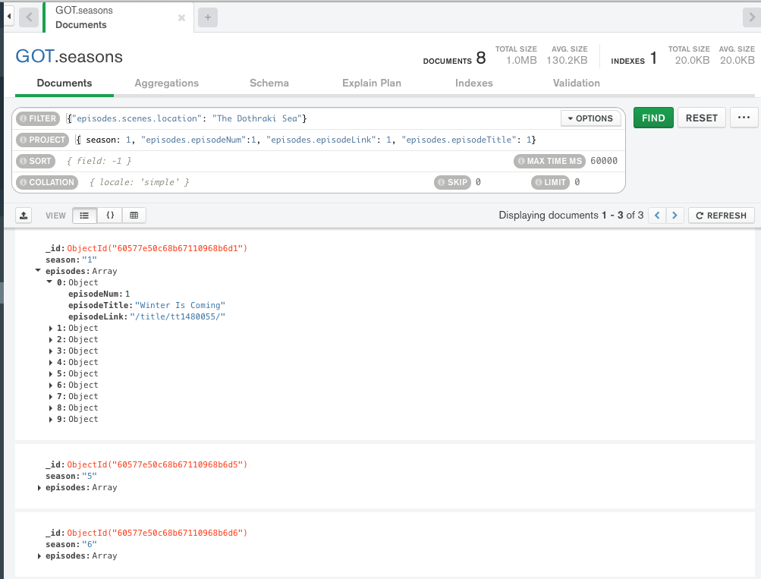
find()
Note:
MongoDB uses a more pymysql approach, e.g. an API, than pure declarative languages like SQL.
The parameters for find() are where the declarative language appears.
The basic forms of find() and find_one() have two parameters:
filter expression
Project expression
You can use the Compass tool and screen captures for some HW and exam answers.
What if I want the answer in a Jupyter Notebook?

Slide 89
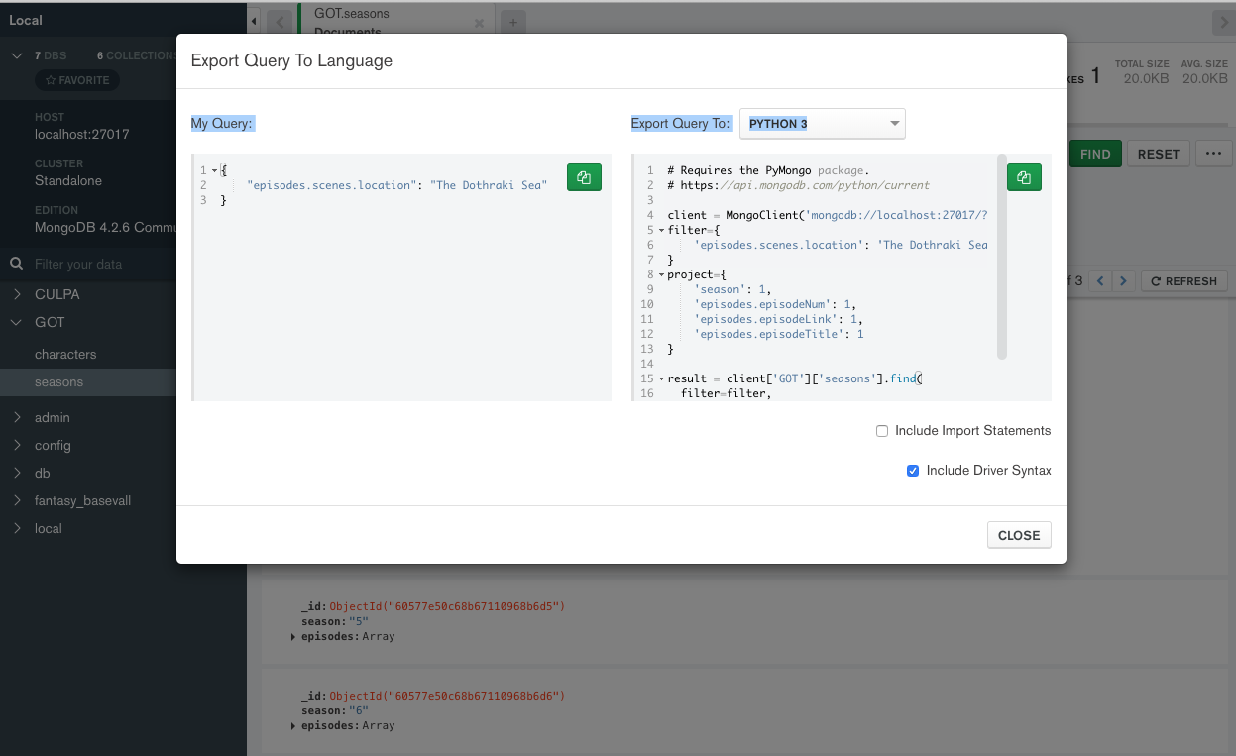
Generate Code
Choose Export to Language.
Copy into the notebook.
The export has an option to include all the connection setup, choosing DB, ... ...
Switch to Notebook

Slide 90
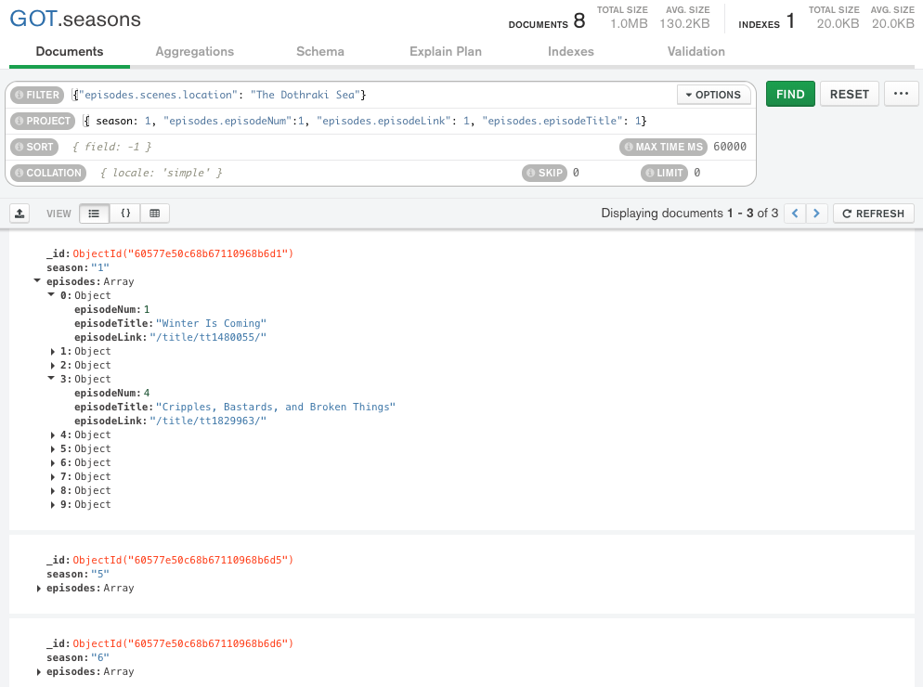
Result is not Quite You Expect
The query returns documents that match.
The document is “Large” and has and episodes and seasons.
If you do a $project requesting episodes/episode content,
You get all episodes in the documents that match.
Not just the episodes with the scene/location.
Projecting array elements from arrays whose elements are arrays is complex and baffling.
You also get back something (a cursor) that is iterable.

Slide 91
Result is not Quite You Expect
The query returns documents that match.
The document is “Large” and has and episodes and seasons.
If you do a $project requesting episodes/episode content,
You get all episodes in the documents that match.
Not just the episodes with the scene/location.
Projecting array elements from arrays whose elements are arrays is complex and baffling.
You also get back something (a cursor) that is iterable.
Net for HWs and exams:
We will keep the queries simple.
The language is as complex as SQL, and we spent several weeks on the language.
Let’s take a look in the Jupyter Notebook on some create and insert functions.
But, first, the datamodel impedance mismatch concept.

Slide 92
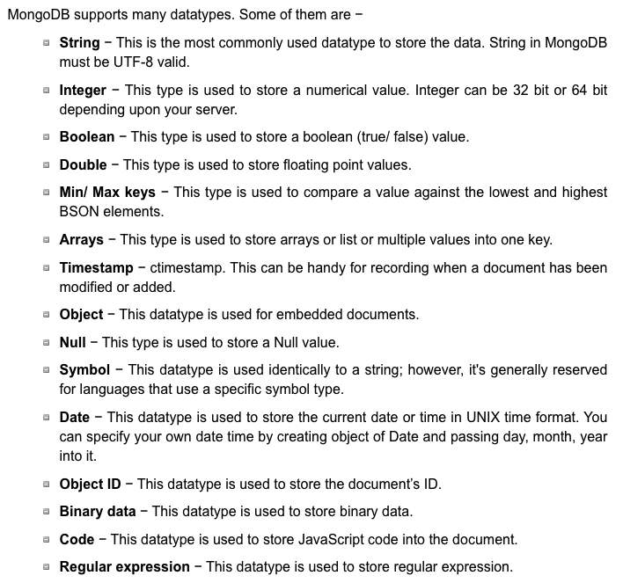
More Fun – Data Types
Python
pymysql
pymongo
SQL
MongoDB

Slide 93
(Some) MongoDB CRUD Operations
Create:
db.collection.insertOne()
db.collection.insertMany()
Retrieve:
db.collection.find()
db.collection.findOne()
db.collection.findOneAndUpdate()
... ..
Update:
db.collection.updateOne()
db.collection.updateMany()
db.collection.replaceOne()
Delete:
db.collection.deleteOne()
db.collection.deleteMany()
pymongo maps the camel case to _, e.g.
findOne()
find_one()
There are good online tutorials:
https://www.tutorialspoint.com/python_data_access
https://www.tutorialspoint.com/mongodb/index.htm

Slide 94
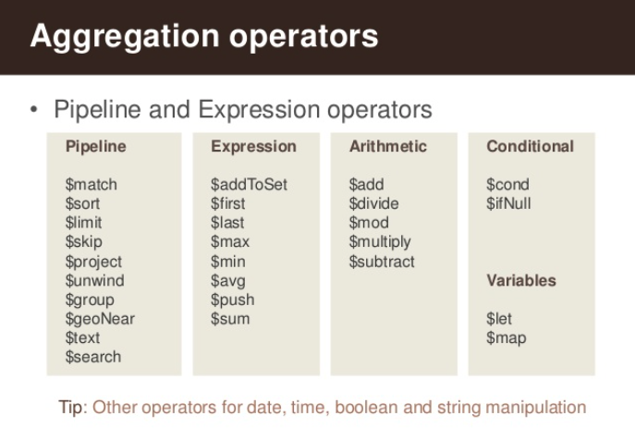
(Some) MongdoDB Pipeline Operators
https://www.slideshare.net/mongodb/s01-e04-analytics

Slide 95
MongoDB Checkpoint
You can see that MongoDB has powerful, sophisticated
Operators
Expressions
Pipelines
We have only skimmed the surface. There is a lot more:
Indexes
Replication, Sharding
Embedded Map-Reduce support
... ...
We will explore a little more in subsequent lectures, homework, ... ...
You will have to install MongoDB and Compass for HW4 and final exam.

